Slide 1
Tutorial 3
(Rest Services, Mashup)
CS551 Advanced Software Engineering
UMKC

Slide 2
Topics to cover
REST Services
Four Square Service
Alchemy Service
Angular JS
Additional

Slide 3
REST Services
Rest(Representational State Transfer) is an architectural style that specifies certain constraints for communication over web.
The REST architectural style constrains an architecture to a client/server architecture and is designed to use a stateless communication protocol, typically HTTP.
In the REST architecture style, clients and servers exchange representations of resources by using a standardized interface and protocol.

Slide 4
REST Operations
Get - Retrieves the current state of a resource
Post - Updates the state of an existing resource
Put - Creates a new resource
Delete - Deletes some info

Slide 5
Four Square Search API
https://developer.foursquare.com/start/search
Search Venues
https://api.foursquare.com/v2/venues/search
Returns a list of venues near the current location, optionally matching a search term.
Parameters
All parameters are optional, unless otherwise indicated.
VENUE_ID : required ID of venue to retrieve.
Response fields
Venue :A complete venue.

Slide 6
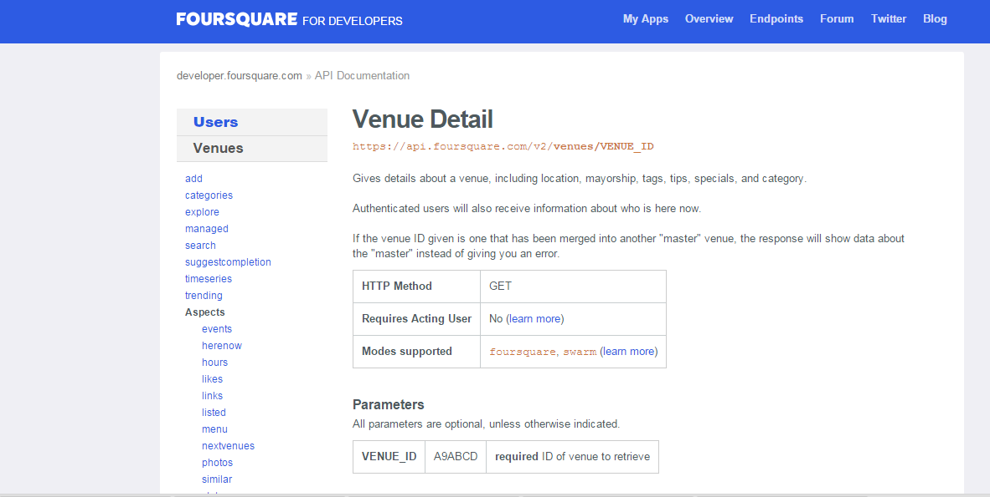
Four Square Search API
https://developer.foursquare.com/docs/venues/venues

Slide 7
Four Square Tips(Reviews) API
https://developer.foursquare.com/start/search
Get Reviews/Tips Venues
Tips from a Venue :Returns tips for a venue.
https://api.foursquare.com/v2/venues/VENUE_ID/tips
HTTP Method : GET
Parameters:
All parameters are optional, unless otherwise indicated.
VENUE_ID XXX123YYYY required The venue you want tips for.
sort recent One of friends, recent, or popular.
limit 100 Number of results to return, up to 500.
offset 100 Used to page through results.

Slide 8
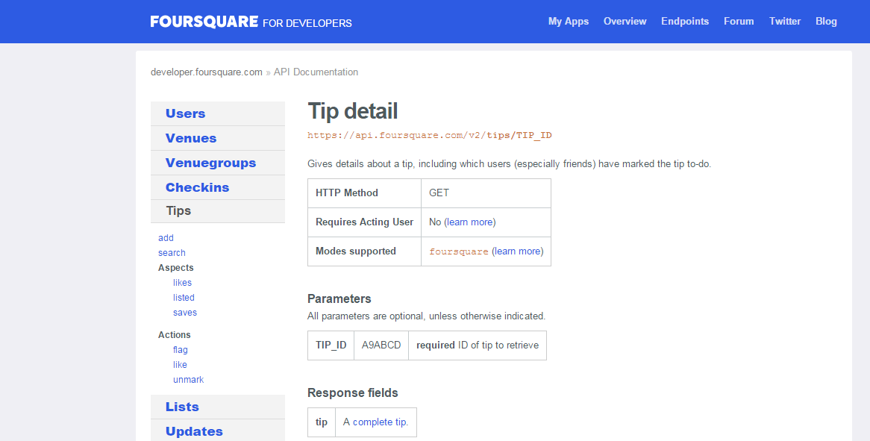
Four Square Tips(Reviews) API

Slide 9
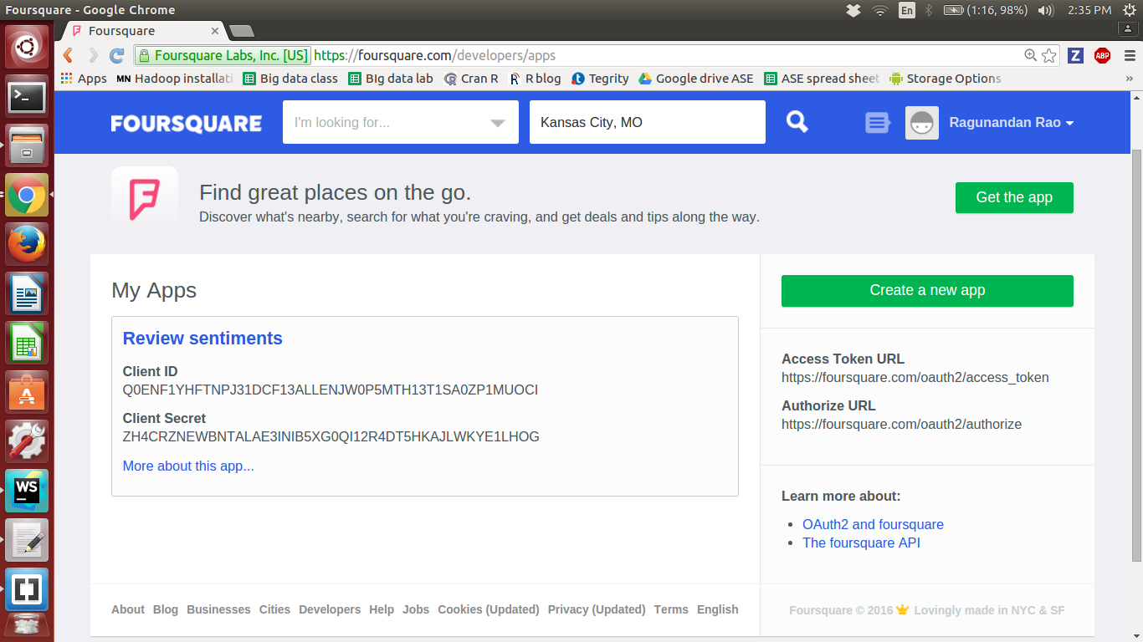
What is needed to Access API ?.... A Key !!!

Slide 10
Alchemy Sentiment Analysis API
AlchemyAPI provides easy-to-use mechanisms to identify positive/negative sentiment within any document or web page.
AlchemyAPI Sentiment Analysis APIs are capable of computing document-level sentiment, user-specified sentiment targeting, entity-level sentiment, emoticons and keyword-level sentiment. Multiple modes of sentiment analysis provide for a variety of use cases ranging from social media monitoring to trend analysis.
API Call: TextGetTextSentiment
Description: The TextGetTextSentiment call is utilized to extract positive/negative sentiment from within a posted text document. Endpoint:
http://gateway-a.watsonplatform.net/calls/text/TextGetTextSentiment

Slide 11
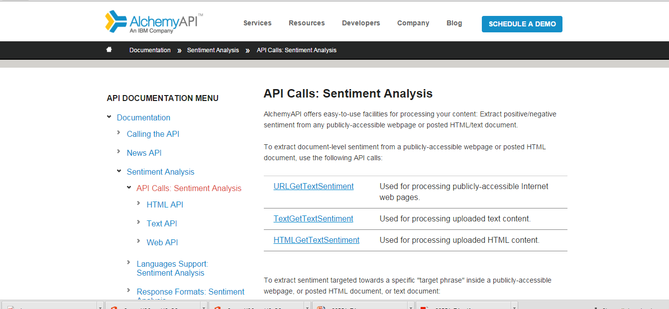
Alchemy Sentiment Analysis API

Slide 12
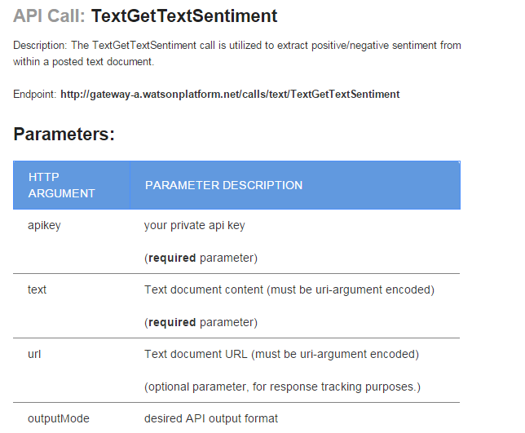
Alchemy Sentiment Analysis API

Slide 13
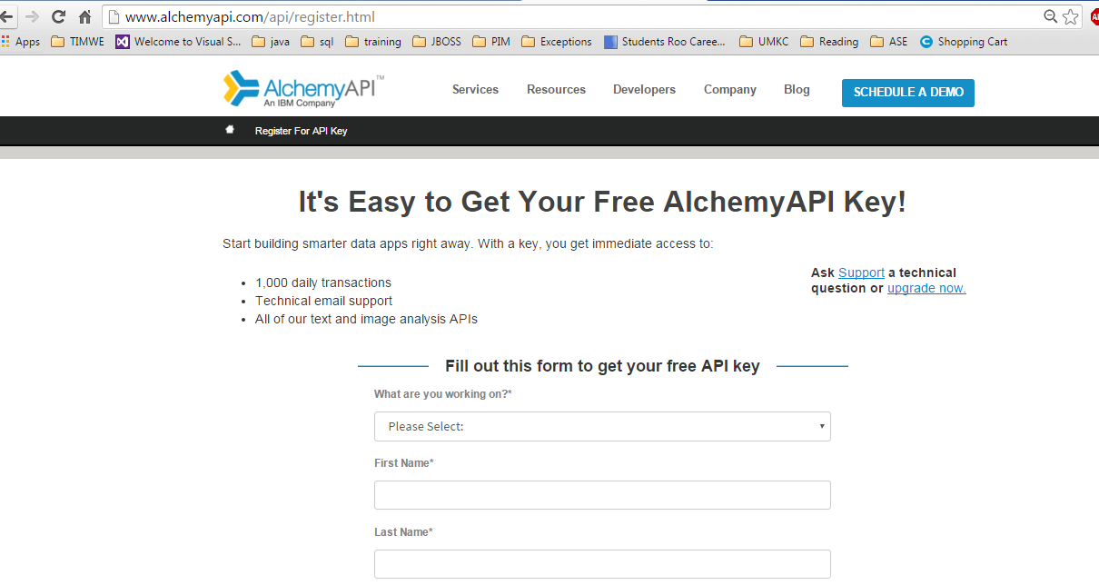
You can get a API key all the times on Developers.ServiceProviderSite !!

Slide 14
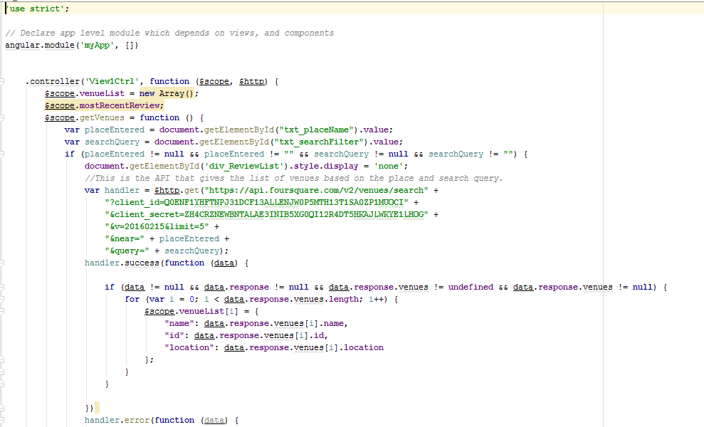
Get Venues in app.js

Slide 15
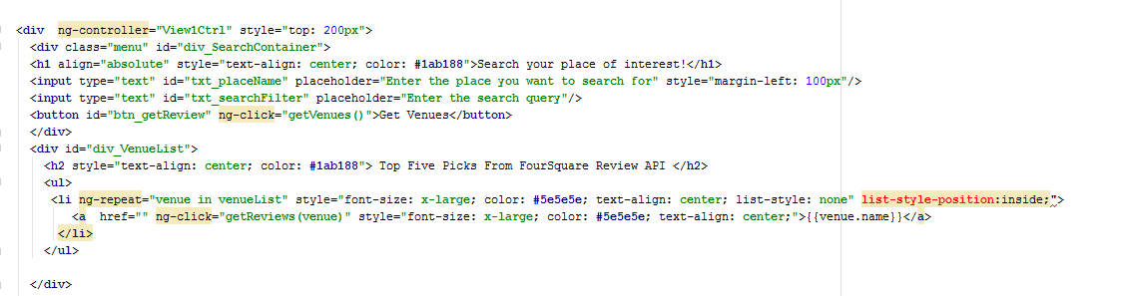
View of venues in .HTML

Slide 16
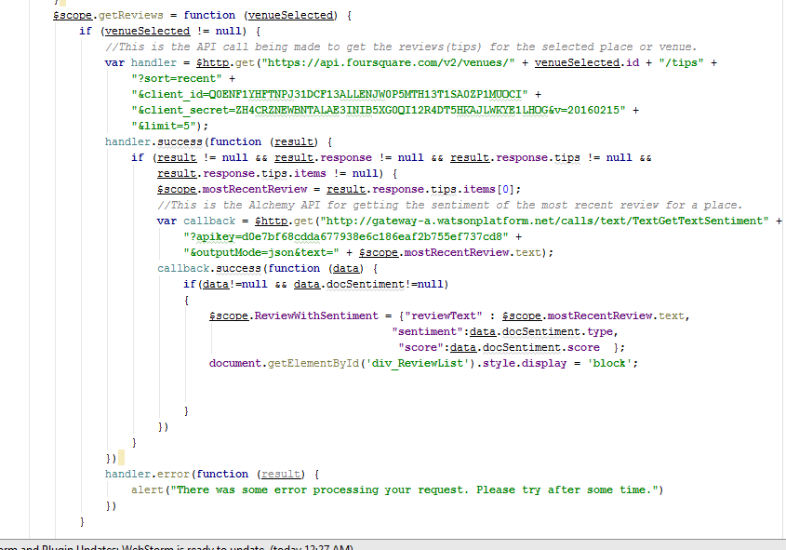
Get Tips in view1ctrl Controller of App.js

Slide 17
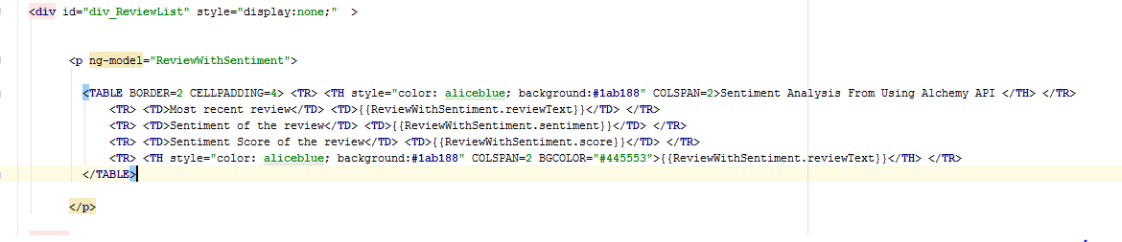
Reviews view on HTML

Slide 18
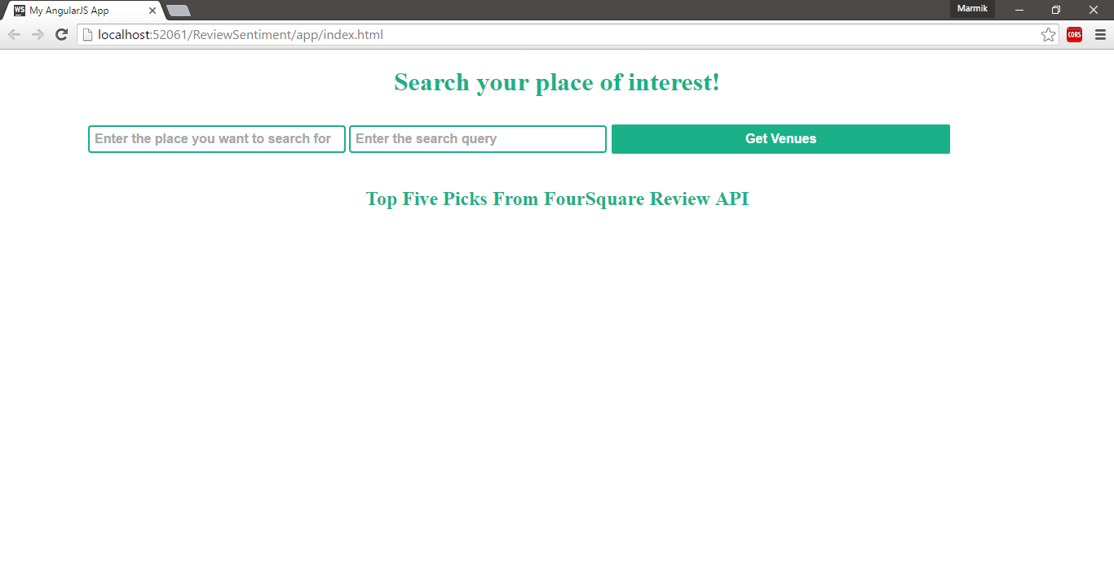
Search using Foursquare API

Slide 19
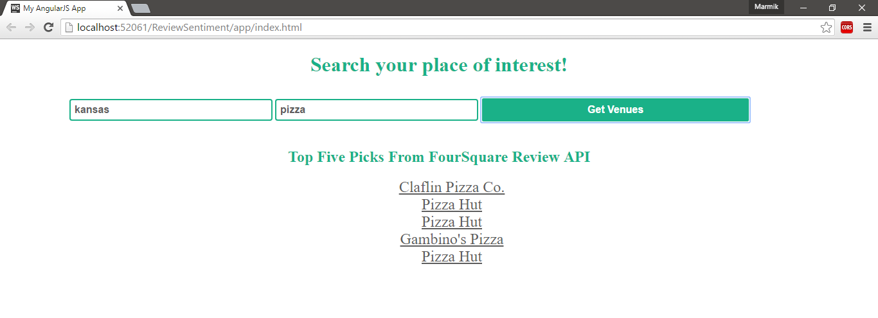
Top 5 Results of Foursquare API

Slide 20
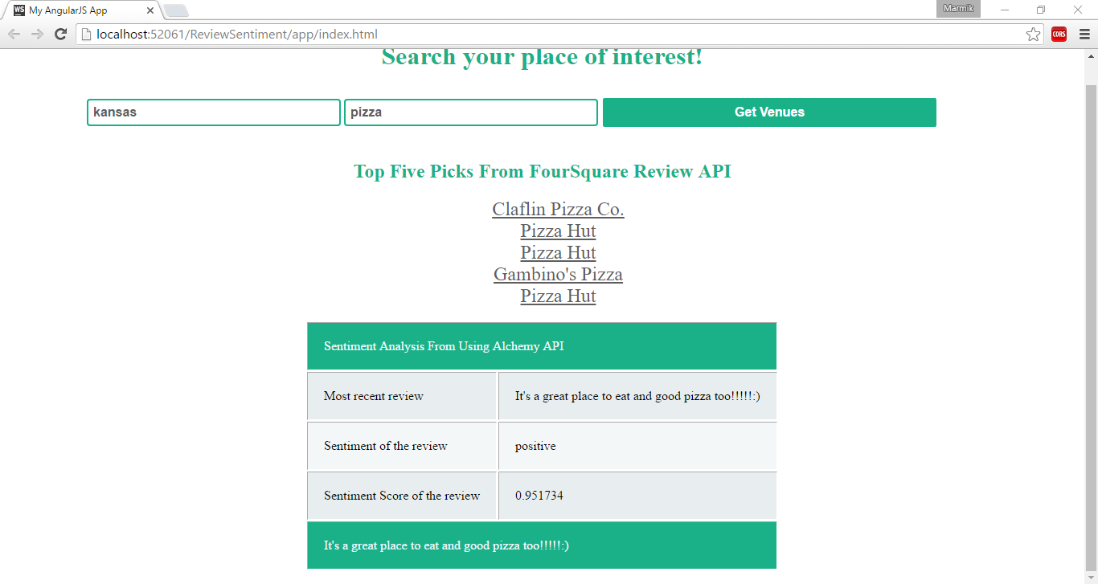
Sentiment Analysis using Alchemy API

Slide 21
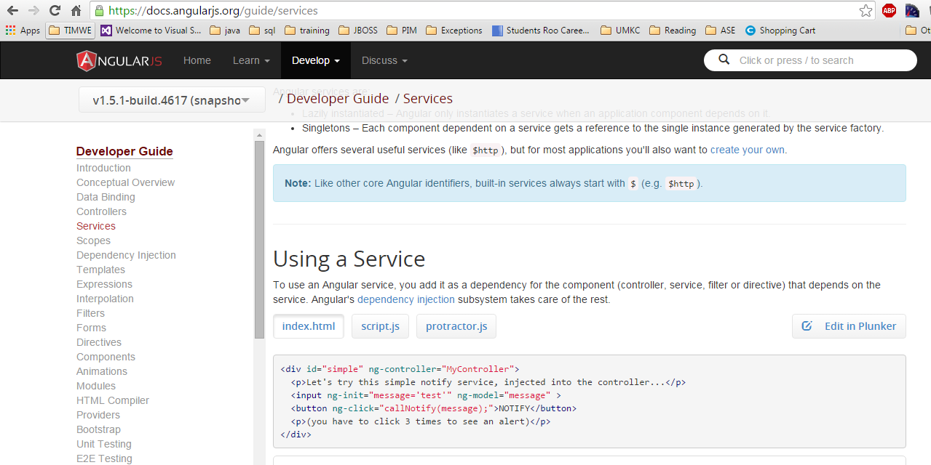
Angular Service

Slide 22
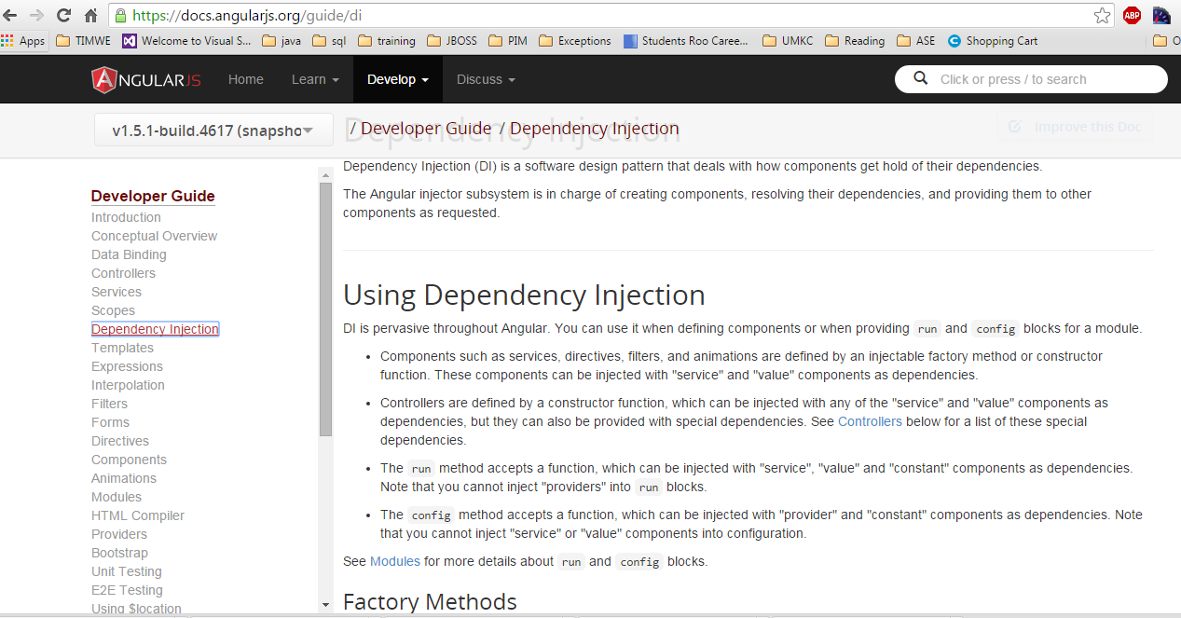
Angular Dependency Injection

Slide 23
Mashup
A mashup, in web development, is a web page, or web application, that uses content from more than one source to create a single new service displayed in a single graphical interface
Example:
http://www.makeuseof.com/tag/10-unique-google-maps-mashups-explore-information/
http://mashable.com/2008/05/14/17-google-maps-mashups-to-waste-away-your-day/

Slide 24
Thank You

